Slide 1
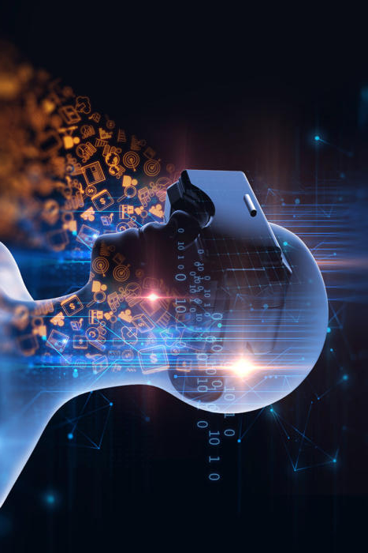
VIRTUAL REALITY

Slide 2
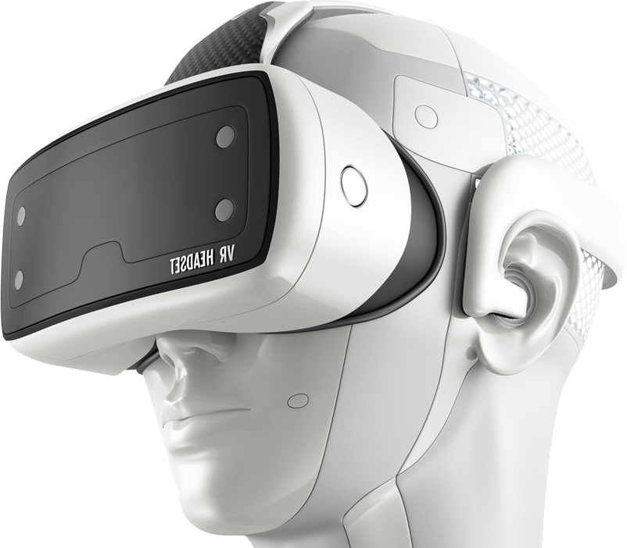
What is Virtual Reality?
Virtual Reality is a computer-generated simulation of a 3-d image or environment that can be interacted with in a seemingly real or physical way by a person using special electronic equipment such as a:
Helmet with a screen inside or
Gloves fitted with sensors.
This immersive environment
can be similar to the real
world or it can be
fantastical.

Slide 3
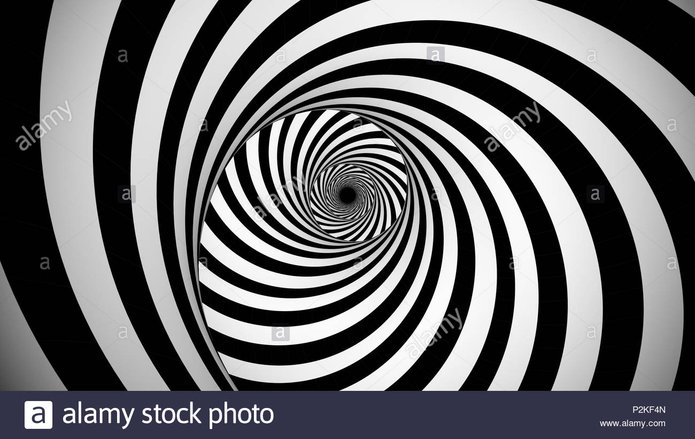

History
The exact origins of virtual reality are disputed, partly because of how difficult it has been to formulate a definition for the concept of an alternative existence.
But The development of perspective in Renaissance Europe created convincing depictions of spaces that did not exist, in what has been referred to as the "multiplying of artificial worlds”.

Slide 4
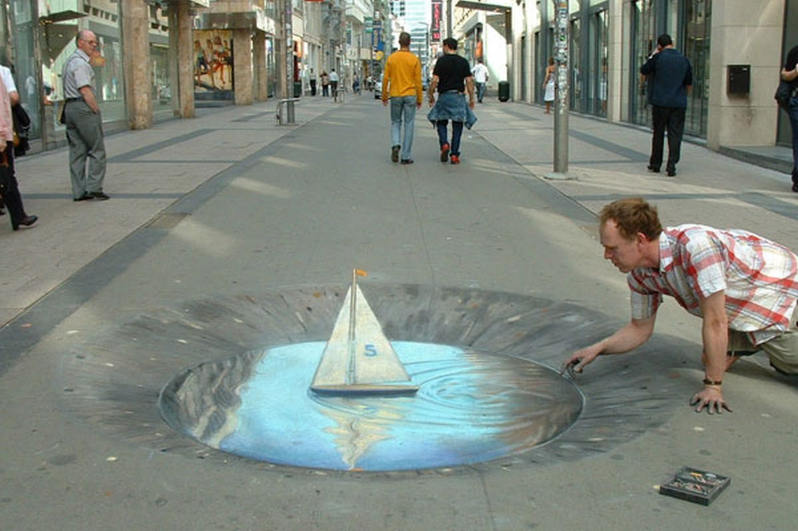

Slide 5
Late 20th century
Morton Heilig wrote in the 1950's of an "Experience Theatre " that could encompass all the senses in an effective manner, thus drawing the viewer into the onscreen activity
. He built a prototype of his vision named the Sensorama in 1962, along with five short films to be displayed in it while engaging multiple senses :

Slide 6
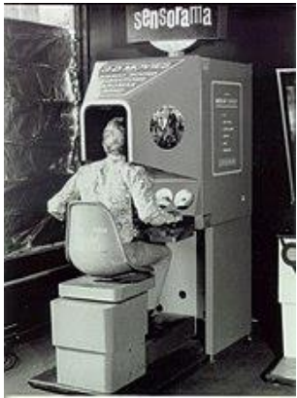
sight
sound
smell and
Touch
Predating digital
compuputing , theSensorama was
a mechanical device.
Heilig also developed what he referred to as the "Telesphere Mask"

Slide 7
.The spectator is given a complete sensation of reality , i.e.
moving three dimensional images which may be in color, with 100% peripheral vision,
binaural sound,
scents and air
breezes.

Slide 8
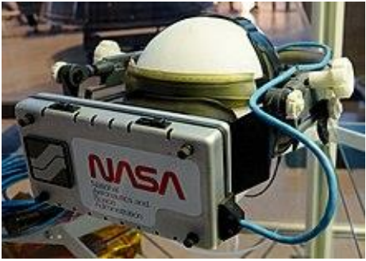
In 1968 what was widely considered to be the first head-mounted display system for use in immersive simulation applications was created.
It was primitive both in terms of user interface and visual realism,
and the HMD to be worn by the user was so heavy that it had to be suspended from the ceiling.
The graphics comprising the virtual environment were simple wire-frame model rooms.

Slide 9
1970–1990
The virtual reality industry mainly provided VR devices for
medical ,
flight simulation ,
automobile industry design , and
military training purposes from 1970 to 1990.
in NASA 's Jet Propulsion Laboratoryworlds first navigable virtual worlds was produced.
In 1978 in MIT The Aspen Movie Map was created ,It is a crude virtual tour in which users could wander the streets of Aspen in one of the three modes
summer,
winter,
and polygons

Slide 10

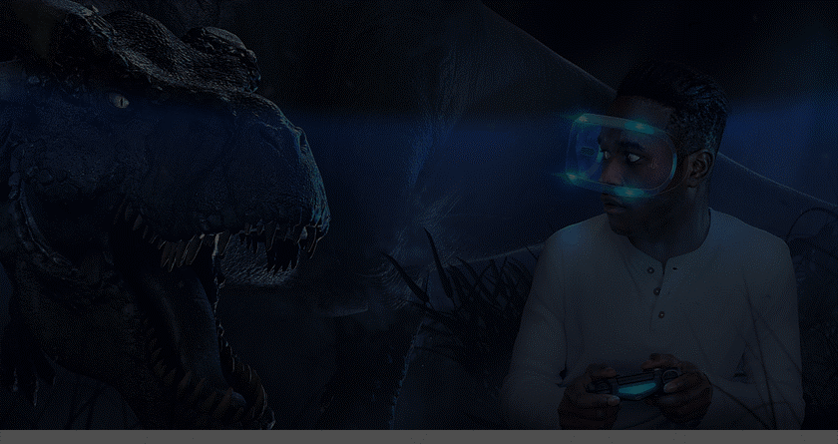
1990–2000
The 1990s saw the first widespread commercial releases of consumer headsets . In 1992, for instance, Computer Gaming World predicted
In 1991, Sega announced the Sega VR headset for arcade games and the Mega Drive console
It used LCD screens in the visor
stereo headphones, and
inertial sensors
that allowed the system to track and react to the movements of the user's head.

Slide 11
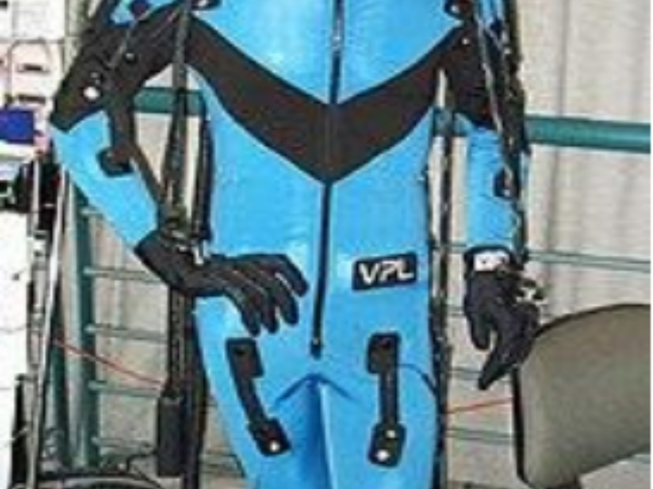
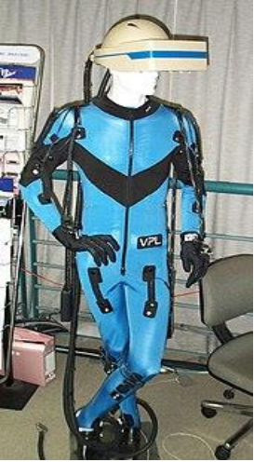
Virtuality launched and went on to become the first mass-produced, networked, multiplayer VR entertainment system that was released in many countries , including a dedicated VR arcade at
Embarcadero Center .
Costing up to $73,000
per multi-pod Virtuality system,
they featured headsets and
exoskeleton gloves that gave
one of the first "immersive " VR experiences.

Slide 12
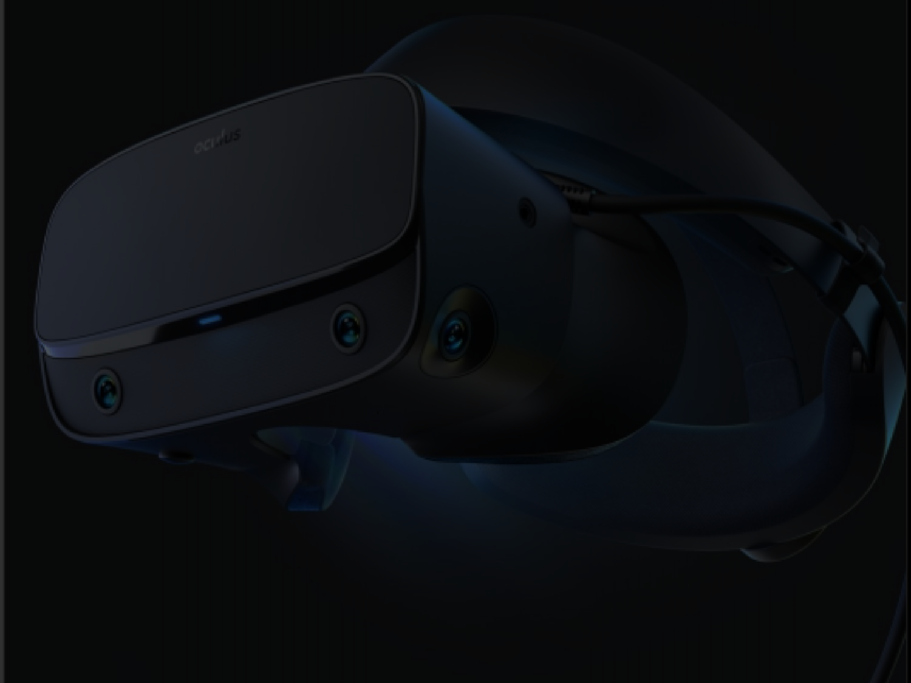
In 2010 , Palmer Luckey designed the first prototype of the Oculus Rif. This prototype ,built on a shell of another virtual reality headset
it boasted a 90-degree field of vision
In 2014 , Facebook purchased Oculus VR for $3.
By 2016 , there have been at least 230 companies developing VR-related products Amazon
Apple Microsoft
Facebook Sony and
Google Samsung
Microsoft ,Sony and Samsung all had dedicated AR and VR groups.

Slide 13
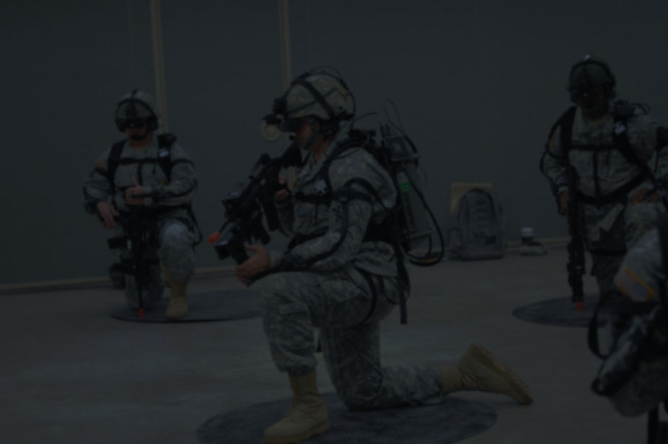
What is VR used for?
1. Military
VR can put a trainee in a number of different situations , places and environments so the military are using it for :
flight simulations
battlefield simulations
medic training
Vehicle simulation and
virtual boot camp
. A key benefit of VR in the military is the education in costs for training .
In addition to this , it can safely replicate dangerous training situations.

Slide 14
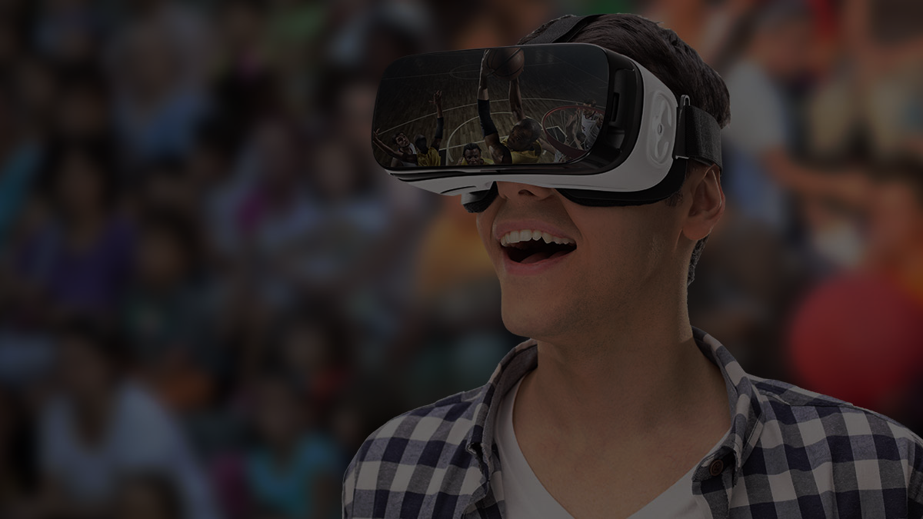
2. Sport
VR is revolutionizing the sports industry for both players and viewers.
It’s being used as a training aid :
to help measure athletic performance and analysis technique.
Broadcasters are now streaming live games in virtual reality and preparing to one day sell “virtual tickets” to live games.

Slide 15

3. Medical Training
Medical and dental students use VR to practice surgeries and procedures , allowing for a consequence free learning environment.
VR has become a primary method for treating post -traumatic stress . Using VR exposure therapy, a person enters a re-enactment of a traumatic event.
to treat anxiety,
phobias and
depression .
Virtual reality technology can provide a safe environment for patients to come into contact with things they fear,
Whilst remaining in a controlled and safe environment.

Slide 16

4. Surgery training
Surgery training can be done via virtual reality . To allow this, 360° video is recorded during operations and the data thus obtained can (together with other data) be shared online .
Through virtual reality ,physicians can produce
a three – dimensional model that patients can see and manipulate.
This allows surgeons to map out the surgery ahead of time.

Slide 17
Advantages and Disadvantages
advantages
Provides outstanding visualizations that are not possible
Creates Interest
Increases Students' Engagement.
Does not Feel Like Work.
Improves the Quality of Education in Different Fields.
Eliminates the Language Barrier.
Used in various fields

Slide 18
disadvantages
While virtual reality can be a great asset for most of the existent fields of activity, it can also be a huge disadvantage
Deteriorates Human Connections.
Lack of Flexibility
Quite Expensive
Users addict to the virtual world .

Slide 19
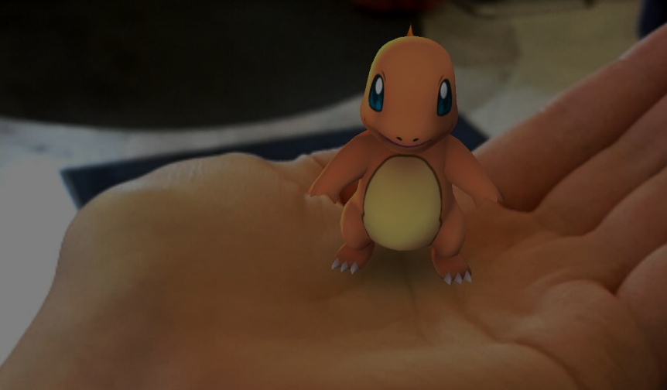
Augmented reality and Mixed reality
Augmented reality (AR) adds digital elements to a live view often by using the camera on a smartphone. Examples
Snapchat lenses and
Pokemon Go.

Slide 20
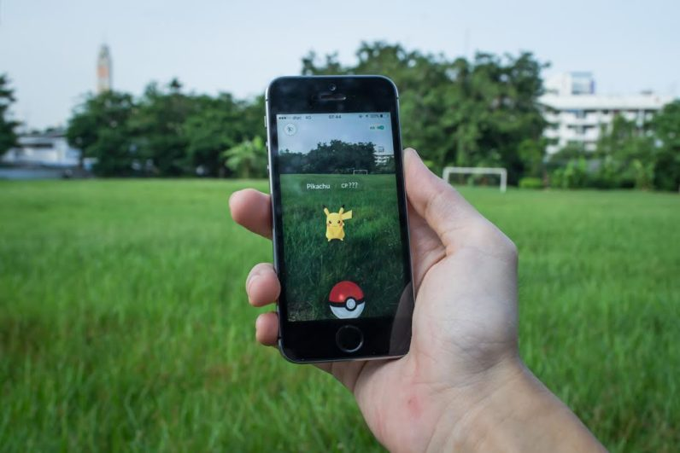

Slide 21
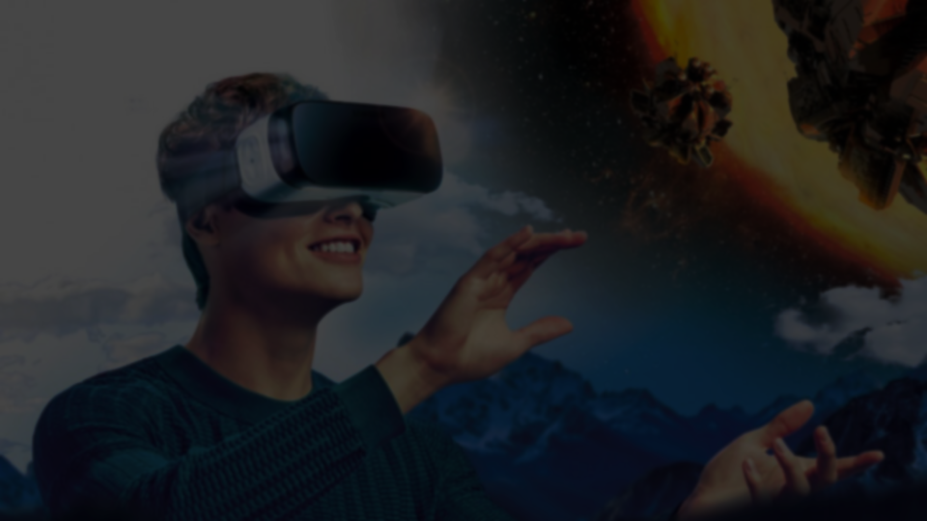
Virtual reality (VR): implies a complete immersion experience that shuts out the physical world.
Using VR devices such as
HTC Vive
Oculus Rift or
Google Cardboard,
users can be transported into a number of real-world and imagined environments such as the middle of a squawking penguin colony or even the back of a dragon.

Slide 22

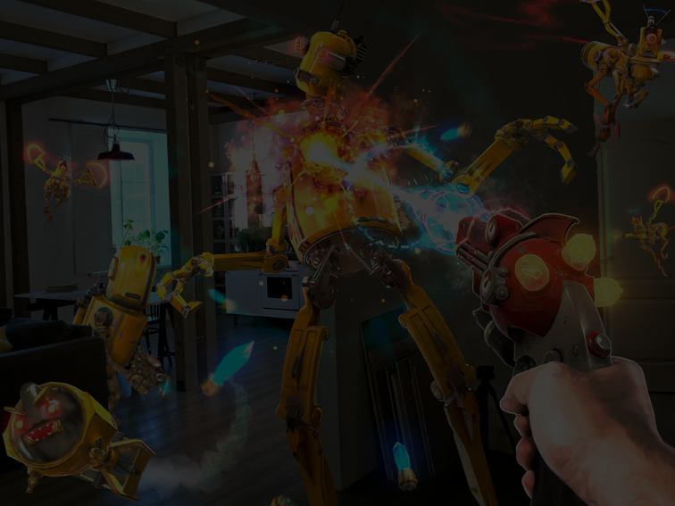
Mixed reality (MR)
experience , which combines elements
Of both AR and VR,
Real-world and digital objects interact.
Mixed reality technology is just now starting to take off with Microsoft’s HoloLens one of the most notable early mixed reality apparatuses.

Slide 23
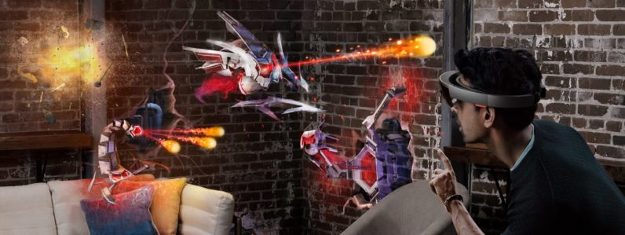
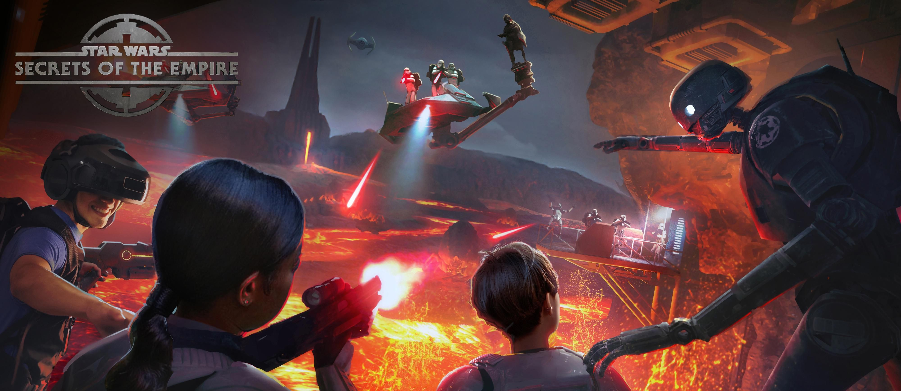

Slide 24
Conclusion
As you have probably noticed, the virtual reality environment is consistently evolving. It could bring dozens of benefits to almost any field, but it can also prove to be harmful. We believe that the modernization of different fields like medicine, military, sport, entertainment through the use of virtual reality can be quite a productive accomplishment.

